Slide 1
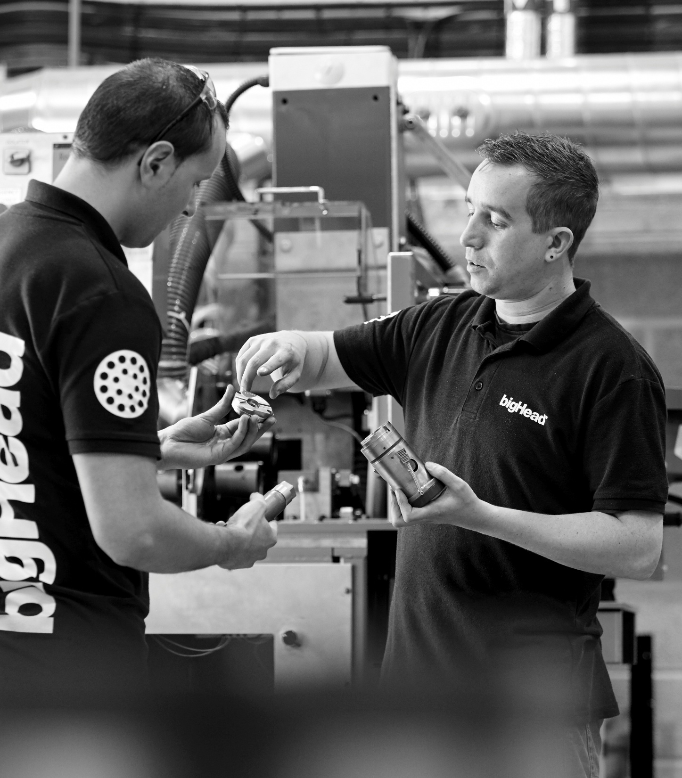
Introduction to bigHead
May 2025

Slide 2

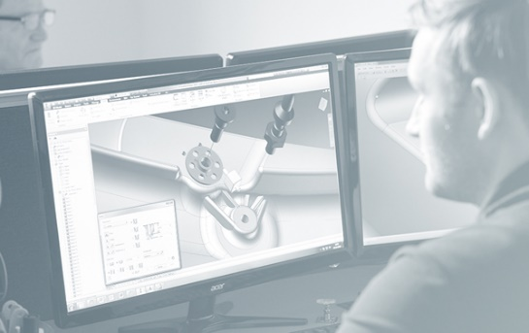





Who we are
We are open with each other, and with our partners, because true collaboration demands trust.
We are diligent because we know our customers rely on us.
We are ingenious because we know that great thinking equals great performance.
We are brave because no challenge is too big, and it takes courage to discover something new.
We are optimistic because we are working together to create a better future.

Slide 3






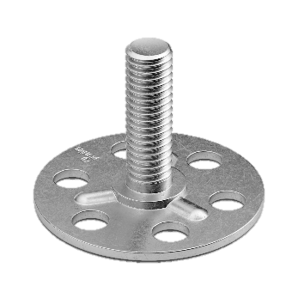



UK based manufacturer
Company & manufacturing based in Verwood, Dorset
In business since 1966
~ 3’000 customers
Distribution partners in 48 countries
ISO 9001:2015 certified
EN 1090-1:2009+A1:2011 certified
REACH, ROHS & ELVD compliant
Carbon neutral since 2019
Development office at Cranfield University Technology Park, Bedfordshire
CRANFIELD
CO²
<0>
ISO-9001
EN-1090
VERWOOD
(Bournemouth)

Slide 4

Wider expertise
Since 2014 we are part of Bossard group:
Global network of companies headquartered in Zug, Switzerland.
Helps us share expertise across Europe, the Americas and Asia-Pacific.
Bossard employs over 2,000 people in more than 60 locations
© copyright Bossard 2025

Slide 5
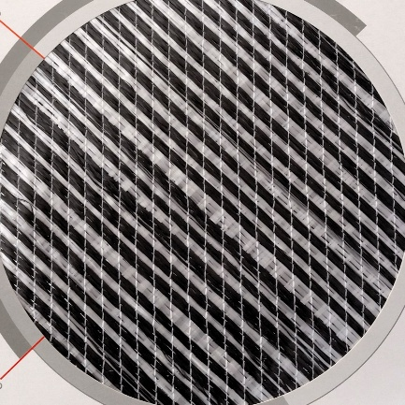
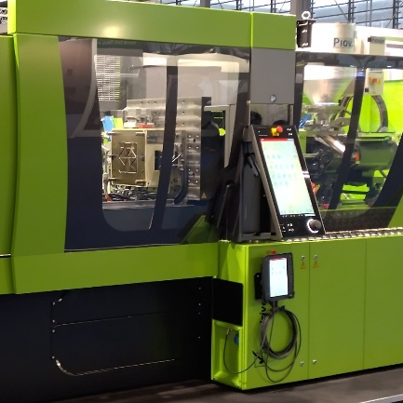
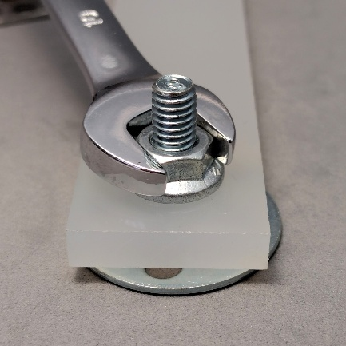
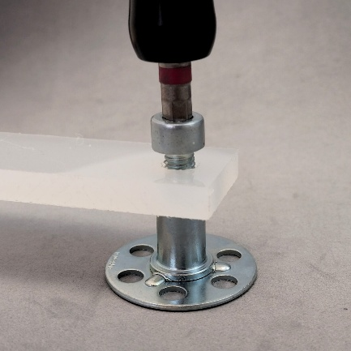
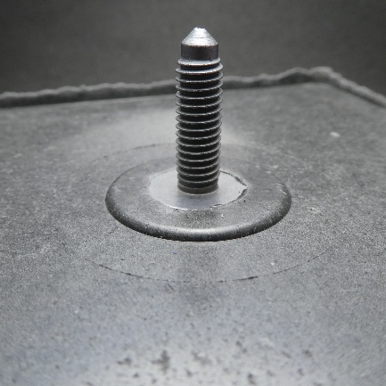
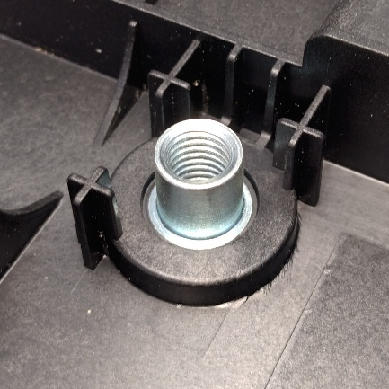
Our expertise
Composites & plastics
We offer a unique combination of knowledge and experience:
Composites & plastics materials & manufacturing processes
Fastening and assembly
Fastening
Composite & plastic fastening

Slide 6
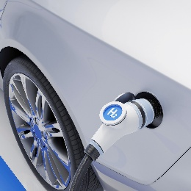

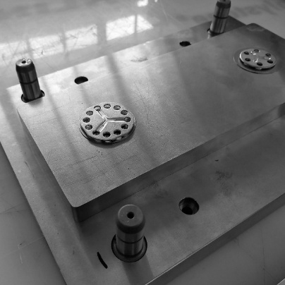
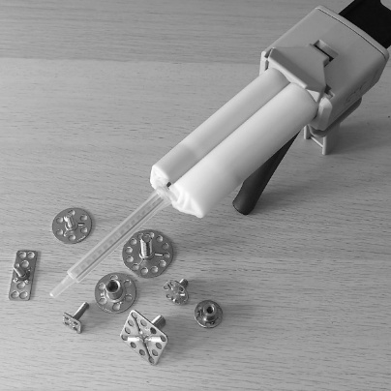
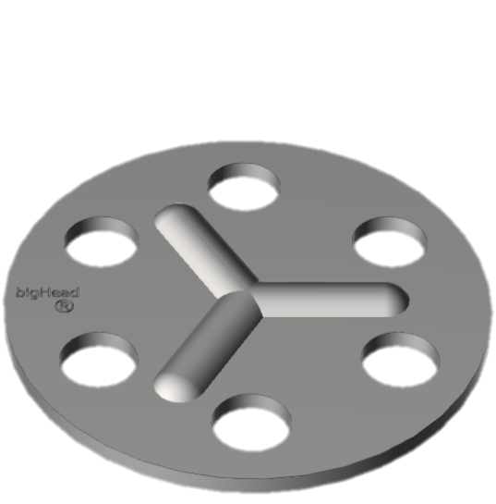



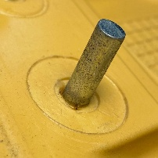
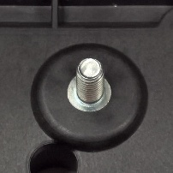
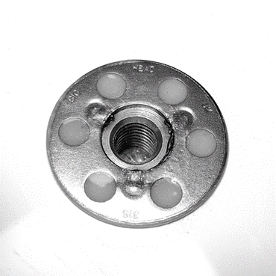
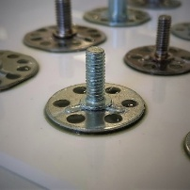

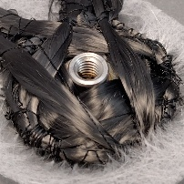
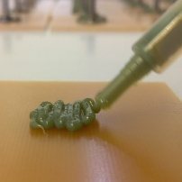


Our products
Provide a load spreading connection into materials that have point loading sensitivity
Installation by embedding (co-process) or surface bonding (post-process)
Utilised in multiple applications and market sectors including:
Automotive & EV
Land transport & off-highway
Marine
Wind energy
Rail
Construction

Slide 7

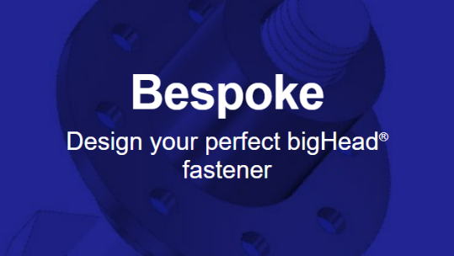










What we offer
Predefined type & size availability
Custom made fasteners
Technical information & support
Technical data sheets provided
Simplified design & development
Composites & fastening expertise
PPAP & ISIR available on request*
Assured performance & quality
Applications development & testing*

